Slide 1

Department of Computer Science, CUI Lahore Campus
Formal Methods in Software Engineering
By
Farooq Ahmad

Slide 2
Function operators
Function overriding, function application

Slide 3
Topics covered
Function overriding
Function application
Relational image as function application
Constructor functions

Slide 4
Function operators
The notions of domain, range, domain subtraction, range subtraction, domain restriction, range restriction, inverse and composition apply to functions because they are relations.
Note, however, that the inverse of a function might not be a function.
Similarly, because functions are sets we can use them in constructions involving union, intersection and difference, though the union of two functions might not be a function.

Slide 5


Function overriding
To combine the information contained in functions f and g, we could simple write f$⨁g.$
Further, the overriding operator is used to update the information.

Slide 6
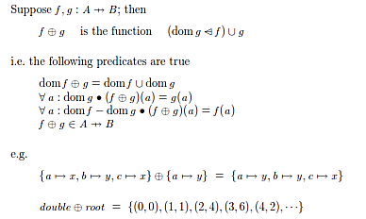
Function overriding

Slide 7
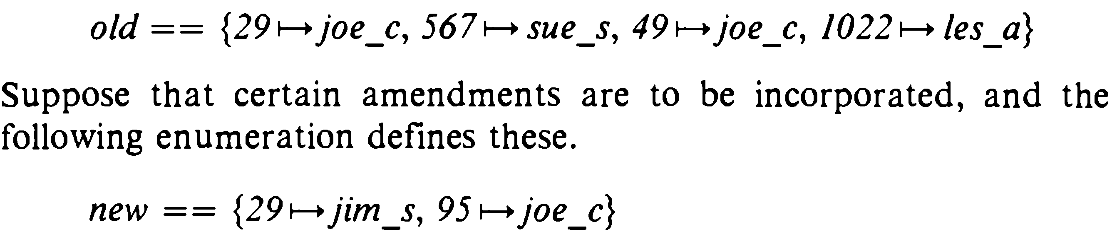

Example
Suppose that the present value of the lent_to function in the library is given by the following set enumeration, where the names denote values of the appropriate types.

Slide 8

Exercise for function overriding

Slide 9
Function application
Finding the single item associated with an element by a function is called function application.
Given the declaration of lent_to , suppose that b: Book is in the domain of lent_to.
Then we apply lent_to to b, and write lent_to (b) to denote the person to whom the book b has been lent.
In this expression the value b is called the argument of the function application, and lent_to b is the value of the function for argument b.
For the function isqrt declared we have isqrt 9 = 3

Slide 10
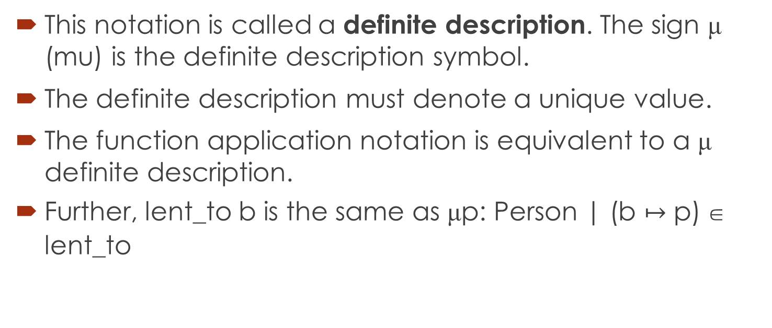
Mu notation for function application
This notation is called a definite description. The sign μ (mu) is the definite description symbol.
The definite description must denote a unique value.
The function application notation is equivalent to a μ definite description.
Further, lent_to b is the same as μp: Person | (b $↦$ p)  lent_to

Slide 11
Relational image as function application
Function application is a special case of relational image.
Lent_to (|{b} |) = {p}
Where set {b} is an argument passed to function lent_to and relational image operator returns the image of the book b.

Slide 12
Data type definition
Suppose that in investigating the requirements for the library management system we had formed the opinion that the librarian made a firm distinction between fiction books and non-fiction books, and we responded to this by making two given sets thus:
[Fiction, Non_fiction]
How shall we construct a type Book that covers both kinds?
Set union is not possible, because Fiction and Non_fiction are different types.

Slide 13
Constructor functions
The following definition constructs a new type Book from Fiction and Non_Fiction.
This definition introduces three names: the new type Book, and two constructor functions fict and nfict.
fict: Fiction → Book and nfict: Non_Fiction → Book
The purpose of the constructor functions is to convert values of the contributing types Fiction and Nonfiction to values of the new type Book. The signs '<< and >>' are called disjoint union brackets.

Slide 14
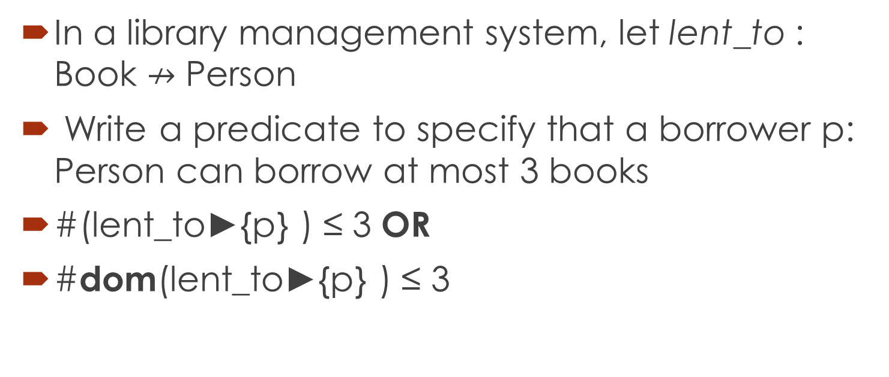
Constructing predicates about software design
In a library management system, let lent_to : Book $↛$ Person
Write a predicate to specify that a borrower p: Person can borrow at most 3 books
#(lent_to►{p} ) ≤ 3 OR
#dom(lent_to►{p} ) ≤ 3

Slide 15
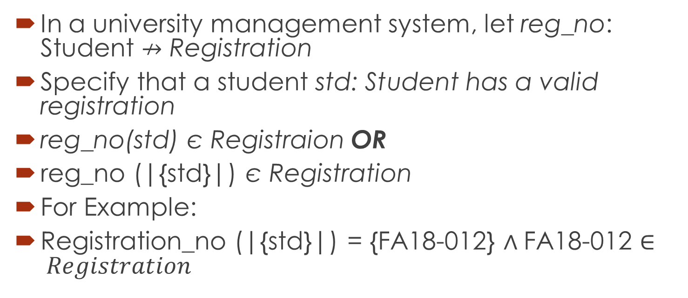
Constructing predicated: Example 2
In a university management system, let reg_no: Student $↛$ Registration
Specify that a student std: Student has a valid registration
reg_no(std) є Registraion OR
reg_no (|{std}|) є Registration
For Example:
Registration_no (|{std}|) = {FA18-012} $∧$FA18-012 $∈ Registration$

Slide 16
Summary of the lecture: Conclusion
Function operators
Function application
Constructor functions
Specifying the predicates

Slide 17
Reference and reading material
Chapter 4: Section 4.2.5, 4.2.8 and Section 4.2.9 of the book “Software development with Z”

